Slide 1
Investigating Employee Retention and Gender in the Workplace
Grant Corbett, Brady Chua , Lachlan Liu, Kendall Nguyen

Slide 2
Key Objectives
01. Employee Satisfaction & Retention
02. Salary & Benefits Impact
03. Gender Discrimination & Departments
How are satisfaction and retention related?
How does salary impact employee retention rates?
How do different benefit packages impact employee satisfaction scores?
How does salary and job satisfaction differ among genders?
Do departments have different levels of job satisfaction and retention rates?

Slide 3
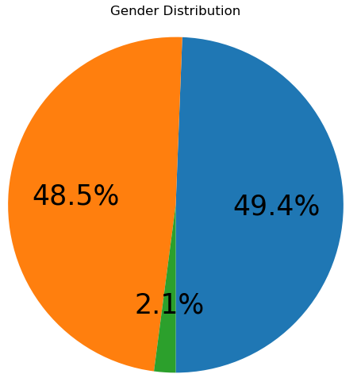
Workforce Snapshot: Retention Rate, Job Satisfaction and Gender Breakdown
63%
Overall Retention Rate
Female
Male
Non-Binary
Average Job Satisfactions across company:
(5 individuals)
Male : 4.7/10
Female : 4.2/10
Overall : 4.4/10
Departments Size (number of people):
Smallest
Biggest
HR
Finance
Marketing
IT
Sales
41
42
44
49
91

Slide 4
Data Description
Numerical Variables
Age; Salary; Performance_Score; Training_Hours; Job_Satisfaction;
Years_at_Company
Categorical Variables
Gender; Benefit-Package;
Education; Year; Department,
Employee_ID, Retention_Status
Sample Details:
Sample size: 267 employees
Total variable: 13
Unit of observations:
Individual employee
Employee Retention and Gender Discrimination Analysis
Scope:
Data collected from 2022 to 2024
Focuses on employee-level retention status
Includes demographics, job data, and performance metrics
Limitations & Errors:
Ignores work-life balance, overtime, and total hours
No measure of work culture
Minimal employee demographic data

Slide 5
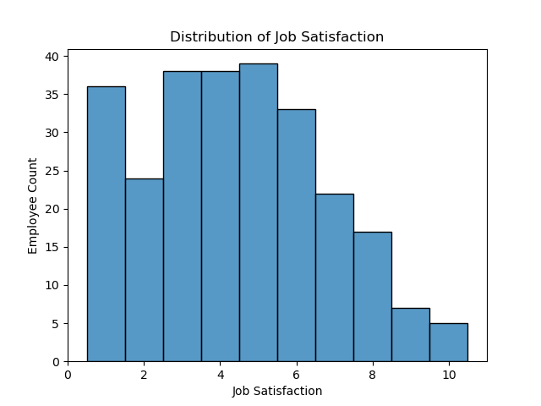
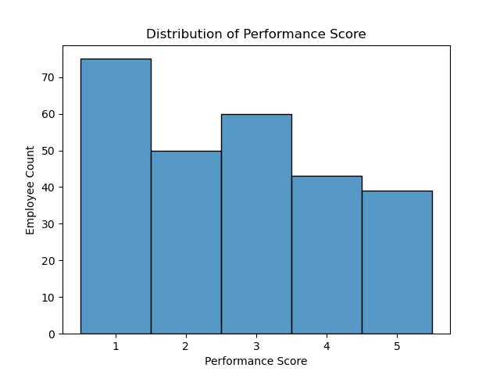
Descriptive Analysis
Skewed Right
No Outliers
Mean of 4.42, Median of 4.0
Spread of 9 (1 - 10)
Slightly Skewed Left
No Outliers
Mean of 2.7, Median of 3.0
Spread of 4 (1 - 5)

Slide 6
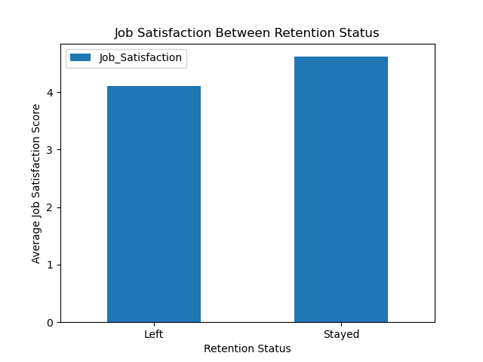
Job Satisfaction Between Employees Who Left or Stayed
Average Job Satisfactions across Retention Status:
Left the Company : 4.1/10
Stayed at Company : 4.6/10
Job Satisfaction Difference : 0.51
However, at the 95% confidence level, we find that the difference of job satisfaction between retention status is not statistically significant
Notes:
Add title to the graph

Slide 7
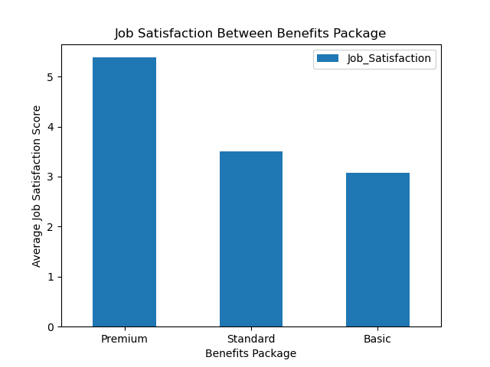
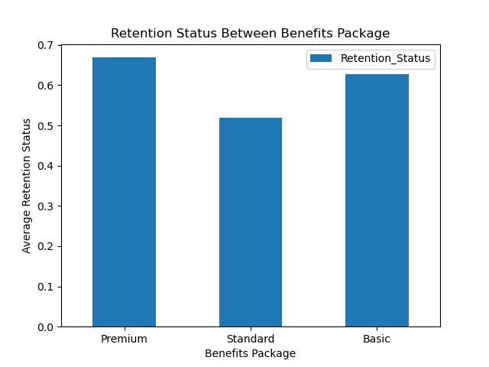
Benefits Package Regressions
Average Job Satisfactions across Benefits:
Average Retention Status across Benefits:
Premium : 5.4/10
Statistical Significance
Premium : 67%
No Statistical Significance
Standard : 3.5/10
Standard : 52%
Basic : 3.2/10
Basic : 63%
Notes:
Add titles to the graphs to fix it

Slide 8
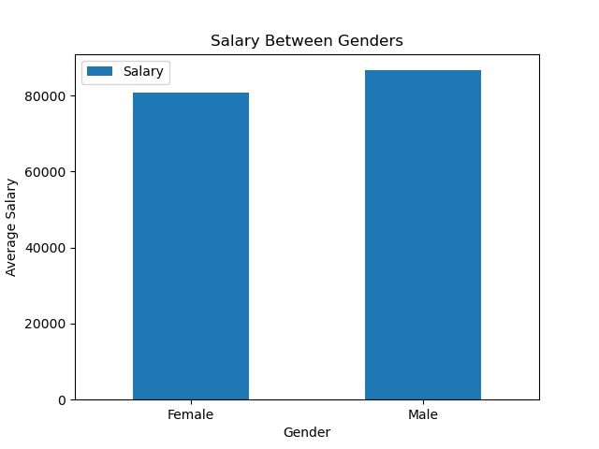
Salary and Gender Regressions
Average Salary across Genders:
Female : $80,888
Male : $86,625
Difference : $5,737
The expected change in salary is $5,661 from female to male employee
The difference is statistically significant at the 95% confidence level
Notes:
Add titles to the graphs to fix it

Slide 9
Identifying Confounding Variables
Job Satisfaction Example:
We used bivariate significance screening to find confounders.
If the potential confounding variable is significant for both dependent and independent variables, it’s a confounding variable.
We repeat this with every relevant variable.
Education
Lap 1
✔
Gender
Job Satisfaction
Age
Lap 2
✔
Gender
Job Satisfaction
Salary
Lap 3
Confounder Found
✔
✔
Gender
Job Satisfaction

Slide 10
Reducing Omitted Variable Bias (OVB)
Job Satisfaction
OVB occurs when a relevant predictor is left out of the model and distorts the expected effects of included variables.
Confounding Factors affect both the outcome and one or more predictors.
OVB Results
Dependent Variables | Independent (predictors) | Gender Coef.
Job Satisfaction | Gender | 0.55
Job Satisfaction | Gender + Salary | 0.15
Coefficient interpretation: On average, males report job satisfaction scores that are X higher than women.
Notes:
overstated the gender effect on job satisfaction

Slide 11
Predicting Job Satisfaction
How we found the best predictors of Job Satisfaction
Forward Selection
Backward Selection
Start
Empty Model
Start
Full Model
Does it improve adjusted R² ?
Test Each Variable
What is the variables significance?
Test Each Variable
Add the variable that improved adjusted R² the most
Add Best Variable
Remove variable with the largest insignificant p-value
Remove variable?
Stop when no remaining variables improve adjusted R²
STOP?
Stop when every remaining variable in the model is significant
STOP?
Adjusted R² | 0.35
Adjusted R² | 0.34

Slide 12
Predicting Job Satisfaction
Key Predictors of Job Satisfaction and Results
Variable | Significant? | Coefficient | Interpretation (on average)
Salary | ✔ | 0.42* | Each additional $10k* in salary increases Job Satisfaction on average by 0.42 points.
Years at Company | ✔ | 0.21 | Each additional year at the company increases Job Satisfaction on average by 0.21 points.
Training Hours | ✔ | -0.02 | For each additional training hour, Job Satisfaction decreases by 0.02 points on average.
Gender (Female) | X | -0.41 | Females on average report 0.41 lower Job Satisfaction.
*IT Department | X | -0.36 | IT employees report 0.36 lower job satisfaction.
*Finance Department | X | 0.35 | Finance report 0.35 higher job satisfaction.
Insignificant
*Disclaimer: Estimates for the IT and Finance departments are based on small sample sizes (<30) and should be interpreted with caution. Other predictors are based on the full dataset and remain robust.
Notes:
training hours were associated with slightly lower satisfaction, possibly due to burnout or inefficiencies.
let kendall talk about our satisfaction and retention findings

Slide 13
Satisfaction & Retention Findings
How are satisfaction and retention related?
Job Satisfaction and Retention:
Status | Avg. JS Score
Employed | 4.6 / 10
Left | 4.1 / 10
On average, people who stay at the company report 0.51 higher job satisfaction scores.
However, Job Satisfaction is insignificant in regards to retention status as its p-value is 0.09 (>0.05).
Predicting Retention:
Retention Status was only significantly influenced by the Sales Department and was only found using backward selection model as forward selection yielded no predictors.
The sales department has an average retention rate 15% higher than the other departments.
Notes:
JS and Retention: Like brady mentioned, there is a difference in job satisfaction between those who left and those who remain employed. However it isn’t statistically significant.
Predicting retention: Retention_Status was only significantly predictable by Department_Sales. The Sales department has a retention rate on average 15% higher than the other departments. This is interesting because the sales department had the lowest average job satisfaction.

Slide 14
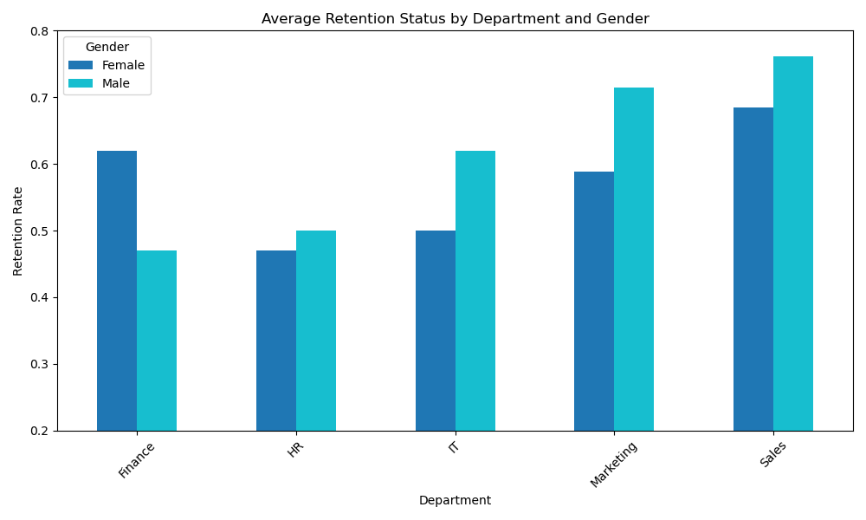
Notes:
To explain this visually, as you can see the sales department has the highest retention rate despite having the lowest job satisfaction. We are limited to the variables we were given so it’s is difficult to determine why the sales department has a significantly higher retention rate. We can speculate that this may have something to do with the culture or contracts that exist with the sales department but we can’t know for sure based on the data.

Slide 15
Salary & Benefits Findings
How does salary and benefits impact satisfaction?
FROM FORWARD SELECTION MODEL: (keeping other predictors we investigated constant)
Variable | Significant? | Coefficient | Interpretation (on average)
Salary | ✔ | 0.42* | Higher salary is significantly associated with higher job satisfaction. 0.42 higher per additional $10k*.
FROM BACKWARD SELECTION MODEL: (keeping Years at Company and Gender constant)
Premium Benefits Package | ✔ | 0.28 | Premium benefits package plans are linked to 0.28 higher job satisfaction scores on average.
Conclusion: Higher salaries and better benefits are significantly associated with higher job satisfaction.

Slide 16
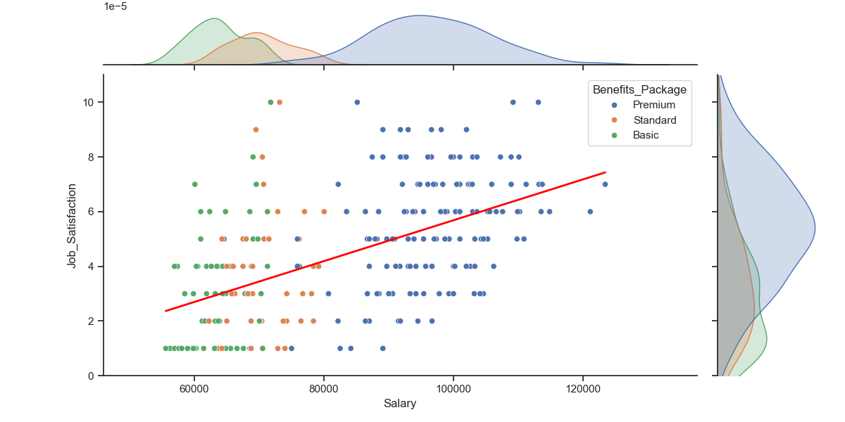
Salary, Benefits, and Job Satisfaction
Notes:
Joint distribution

Slide 17
Gender Differences Findings
Is There Discrimination?
Metrics | Confounding Factors | Significant Difference? | Conclusions & Interpretations
Salary | None | ✔ | On average, males make $5,700 more than their female counterparts.
Benefits Package | Salary | ✔ | Men are predicted to receive better benefits packages than females holding salary constant.
Years at Company | Salary | ✔ | Males on average remain at the company a year less than females do.
Job Satisfaction | Salary | X | Gender does not play a significant role in job satisfaction when Salary is constant.
Conclusion: Yes, there are significant differences between genders when it comes to salary, benefits, and tenure. Women on average get less monetary compensation. *Does not keep department constant

Slide 18
4 Limitations of Our Results
Relatively Small Data Set
Data only contained 267 observations. This means that when we investigated sub groups, significance levels and regressions may become more unreliable.
Limited Analysis Methods
Techniques like supervised machine learning, which lie beyond the scope of this course, could have potentially made predicting variables much easier and reliable.
Self Reported Data
Some data was self reported which could lead to potential biases about the sample. Additionally, we did not directly collect the data so we have no way to verify it’s validity.
Limited Variables
We are limited by the variables we were given. Leaving out many potential variables that are important in an office context. Examples include work life balance, culture, etc.

